Slide 1

UNIVERSITY OF AGRICULTURAL SCIENCES, COA GKVK, BANGALORE – 560065
Silkworm Disease Detection
EfficientNet-B3 Powered
Using Artificial Intelligence
🐛
and Machine Learning
EAI421 – Application of AI & ML in Agriculture (0+10)
AI-Powered
Disease
Detection
Submitted by: DIKSHA [AMB2065] | Manasa M [AMB2130] I MAHESH PATIL [AMB2124]
IV Year B.Sc (Hons.) Agriculture | Guided by: Dr. D R Kumar Raja - Reva University
Academic Year: 2025–2026
Silkworm Disease Detection Using AI & ML | 16 April 2026
1
Notes:
1

Slide 2
Table of Contents
Overview of Presentation
01
Introduction & Overview
06
Literature Survey
02
Problem Statement & Existing System
07
System Requirements
03
Proposed System (Silk Shield)
08
Implementation Phases
04
Silkworm Diseases – An Overview
09
System Testing & Results
05
System Architecture & Methodology
10
Conclusion & Future Scope
Silkworm Disease Detection Using AI & ML | 16 April 2026
2
Notes:
2

Slide 3
Introduction – Sericulture & Challenges
Why AI in Silk Production?
What is Sericulture?
India's Share
~77%
Sericulture is the cultivation of silkworms for silk production — a key agro-industry supporting rural & urban economies worldwide.
Silkworm diseases spread rapidly, destroying entire batches and causing severe economic losses.
Traditional detection methods rely on manual inspection — slow, error-prone, and often too late to prevent outbreaks.
AI & Deep Learning can revolutionize this process through fast, accurate, real-time image-based diagnosis.
of Global Silk Production
Economic Impact
₹Crores
Lost Annually to Diseases
AI Accuracy
96–98%
Disease Detection Rate
Silkworm Disease Detection Using AI & ML | 16 April 2026
3
Notes:
3

Slide 4
Major Silkworm Diseases
Understanding the Threats
🦠
🧫
🍄
⚫
Grasserie
Flacherie
Muscardine
Pebrine
Viral
Bacterial
Fungal
Protozoan
Inter-segmental swelling, yellowish body. Larval body ruptures. Haemolymph oozes out.
Common in Summer & Rainy seasons. Spreads via contaminated mulberry leaf.
Occurs in rainy/winter seasons. Larva vomits and turns flaccid, covered in white spores.
Transmitted via eggs or contaminated leaf. Black pepper-like spots on body.
⚠️ A single infected silkworm can spread disease to the entire batch — early detection is CRITICAL!
Silkworm Disease Detection Using AI & ML | 16 April 2026
4
Notes:
4

Slide 5
Existing System & Problem Statement
What's lacking today?
Existing System – HOG + SVM
Core Problem Statement
Dataset: 668 healthy + 574 Grasserie images
Silkworm diseases cause:
HOG feature extraction + KPCA dimensionality reduction
Substantial economic losses for farmers
SVM classifier – achieved 93.16% accuracy
Rapid spread when undetected early
Potential for IoT-based real-time tools
Reduced silk yield quality
❌ Limited to Grasserie disease only
Manual inspection is time-consuming
❌ High resource & time consumption
Subtle early-stage symptoms missed
❌ Does not recommend pesticides/remedies
No real-time automated solution
❌ Requires controlled imaging conditions
Silkworm Disease Detection Using AI & ML | 16 April 2026
5
Notes:
5

Slide 6
Proposed System – Silk Shield
AI-Powered Sericulture Disease Detection Platform
The system leverages EfficientNet-B3 CNN fine-tuned on curated silkworm disease images for real-time diagnosis with actionable recommendations.
📸
Image Upload
🧠
Deep Learning
⚡
Real-Time Alerts
Mobile/web app for farmers to upload silkworm photos via smartphone
EfficientNet-B3 CNN model detects 5 classes: Healthy, Grasserie, Flacherie, Muscardine, Pebrine
Instant disease detection with actionable preventive/curative recommendations
📊
Climate Optimization
🗃️
Disease Database
🌐
Multilingual
Analyzes temperature, humidity & air quality for optimal cocoon rearing conditions
Continuous learning database for improving accuracy over time
Supports regional languages for rural farmer accessibility
Silkworm Disease Detection Using AI & ML | 16 April 2026
6
Notes:
6

Slide 7
Advantages Over Current System
Why Silk Shield is Better
Feature | Existing System | Silk Shield (Proposed)
Disease Coverage | Only Grasserie | 5 Diseases + Healthy
Detection Speed | Manual / Slow | < 2 Seconds
Accuracy | ~93.16% | 96–98%
Remedy Suggestions | ❌ None | ✅ Yes
Mobile Access | ❌ Not Available | ✅ Web + Mobile App
Multilingual Support | ❌ No | ✅ Regional Languages
Climate Optimization | ❌ No | ✅ Yes (Temperature, Humidity)
Cost | High (Lab Setup) | Low (Smartphone Only)
Silkworm Disease Detection Using AI & ML | 16 April 2026
7
Notes:
7

Slide 8
System Architecture – Flow Diagram
End-to-End Processing Pipeline
Step 1: Input
📤 Upload
Cocoon Image
Step 2: Preprocessing
🖼️ Image
Preprocessing
(Resize, Normalize)
Step 3: Feature Extraction
🔬 Feature Extraction
(EfficientNet-B3 Backbone)
Step 4: Inference
🧠 Model Inference
(Trained EfficientNet-B3)
Step 5: Decision
Disease
Detected?
❎ NO → "Healthy"
Silkworms Confirmed
NO
YES
✅ YES → "Disease Detected"
+ Treatment Advice
Silkworm Disease Detection Using AI & ML | 16 April 2026
8
Notes:
8

Slide 9
Proposed System Pipeline – Silk Shield
Detailed Processing Workflow
📱
⚙️
🤖
🎯
💊
📲
🔔
🗃️
1
2
3
4
5
6
7
8
Image Capture
(Mobile/Web Upload)
Image Preprocessing
(Resize, Normalize, Denoise)
CNN Model
(EfficientNet-B3 Fine-Tuned)
Disease Classification
& Confidence Score
Diagnosis + Prevention
/ Treatment Suggestions
Display Results
(Web/Mobile UI)
Real-Time Alert
Notification
Update Disease
Occurrence DB
Key Advantages
✅ Early Disease Detection
✅ Real-Time Alerts
✅ Multilingual Support
✅ Climate-Based Cocoon Optimization
✅ Scalable & Low-Cost
Silkworm Disease Detection Using AI & ML | 16 April 2026
9
Notes:
9

Slide 10
Literature Survey – Key Research Papers
Building on Prior Work
# | Authors | Research Focus | Method | Accuracy
1 | Binson V.A., Manju G. | Automated Disease Detection in Silkworms Using ML | HOG + KPCA + SVM | 93.16%
2 | Md. Islam et al. | Deep Learning for Cotton Disease Prediction | VGG-16/19, Xception Fine-tuning | 98.70%
3 | Gul Munir et al. | Multi-Crop Disease Detection System | ResNet50 + Edge Computing | Promising
4 | W.Q.Li et al. | Pest & Disease Detection via Deep Learning Drones | CNN + HD Imaging + Wireless | High
5 | J.K. Patel et al. | Deep Learning Pest Recognition for Sericulture | CNN on Sericulture Pest Dataset | High
6 | S.L.Nguyen et al. | Climate-Aware Cocoon Quality Optimization | Recurrent Neural Network (RNN) | Field Validated
Silkworm Disease Detection Using AI & ML | 16 April 2026
10
Notes:
10

Slide 11
Related Works & Research Gap
What Motivated Silk Shield?
🌿
🐛
Plant Disease Detection (CNNs)
AI in Sericulture
PlantVillage dataset studies achieved >95% accuracy using AlexNet/VGG16. Most focus on plants, not silkworms.
Limited deep-learning work on silkworm diseases. CNN models for pebrine/grasserie show promise but face dataset limitations.
📱
🌡️
Mobile Apps for Farmers
IoT + AI Smart Farming
Plantix and Krishi Network offer AI-based diagnosis but are generalized — not tailored for sericulture.
Environmental monitoring for greenhouses exists but has NOT been extended to sericulture-specific disease detection.
🔍 Research Gap: No domain-specific, user-friendly AI tool for silkworm disease detection exists → Silk Shield fills this gap!
Silkworm Disease Detection Using AI & ML | 16 April 2026
11
Notes:
11

Slide 12
System Requirements & Specifications
Functional & Non-Functional Requirements
⚙️ Functional Requirements
🏗️ Non-Functional Requirements
Image Pre-processing:
Ease of Use:
RGB → HSV conversion for color-based analysis
User-friendly interface for smooth operation without technical expertise
Feature Extraction:
Efficiency:
Gabor filters for texture & frequency analysis
Optimized to handle large datasets and complex computations
GLCM Features:
Portability:
Energy, mean, homogeneity, standard deviation
Runs on multiple platforms – mobile, web, desktop, edge devices
Image Classification:
Performance:
EfficientNet-B3 for accurate disease identification
Real-time classification with minimal false positives/negatives
Accuracy Optimization:
Scalability:
Advanced feature extraction + robust classifiers
Modular design supports future disease/pest additions
Real-time Processing:
Security:
< 2 second inference time for field use
Secure image upload with malicious file prevention
Silkworm Disease Detection Using AI & ML | 16 April 2026
12
Notes:
12

Slide 13
Technical Requirements & Feasibility
Implementation Stack
Hardware Requirements
Software / Technology Stack
AI Model
✓
Basic Smartphone with Camera
✓
Python + TensorFlow / Keras (Model Training)
✓
EfficientNet-B3 (Pre-trained CNN)
✓
Desktop/Laptop with Internet Access
✓
Flask Framework (Backend REST API Server)
✓
Fine-tuned on Silkworm Disease Dataset
✓
Optional: Raspberry Pi / Jetson Nano for Edge Computing
✓
HTML / CSS / JavaScript (Frontend Interface)
✓
Deployment via TensorFlow Lite / ONNX
✓
OpenCV + PIL (Image Processing Libraries)
✓
~12MB Model Size – Lightweight & Efficient
✅ Technical Feasibility: Readily achievable using current AI frameworks | ✅ Economic Feasibility: Low-cost, open-source | ✅ Operational Feasibility: Easy field adoption
Silkworm Disease Detection Using AI & ML | 16 April 2026
13
Notes:
13

Slide 14
Implementation Phases
Building Silk Shield Step by Step
1
Data Collection & Preprocessing
2
Model Development
3
Backend Development
• Collect labeled silkworm images (healthy + 4 diseases)
• Select EfficientNet-B3 pre-trained CNN
• RESTful APIs with Flask for image uploads
• Data augmentation: rotation, flip, zoom, brightness
• Transfer Learning: freeze base layers, train top layers
• Model inference trigger and response handler
• Resize to 224×224×3 for EfficientNet-B3
• Evaluate: accuracy, precision, recall, F1-score
• Automated alert & recommendation generation
4
Frontend Development
5
Testing & Validation
6
Deployment & Scaling
• Mobile-friendly web UI for image upload
• Field testing with farmers & extension officers
• Deploy on cloud/edge (TF Lite / ONNX)
• Real-time disease prediction display
• Performance tuning from real-world feedback
• Disease occurrence database for continuous learning
• Localization in regional languages
• Security: block malicious file uploads
• Future: IoT integration, government portals
Silkworm Disease Detection Using AI & ML | 16 April 2026
14
Notes:
14

Slide 15
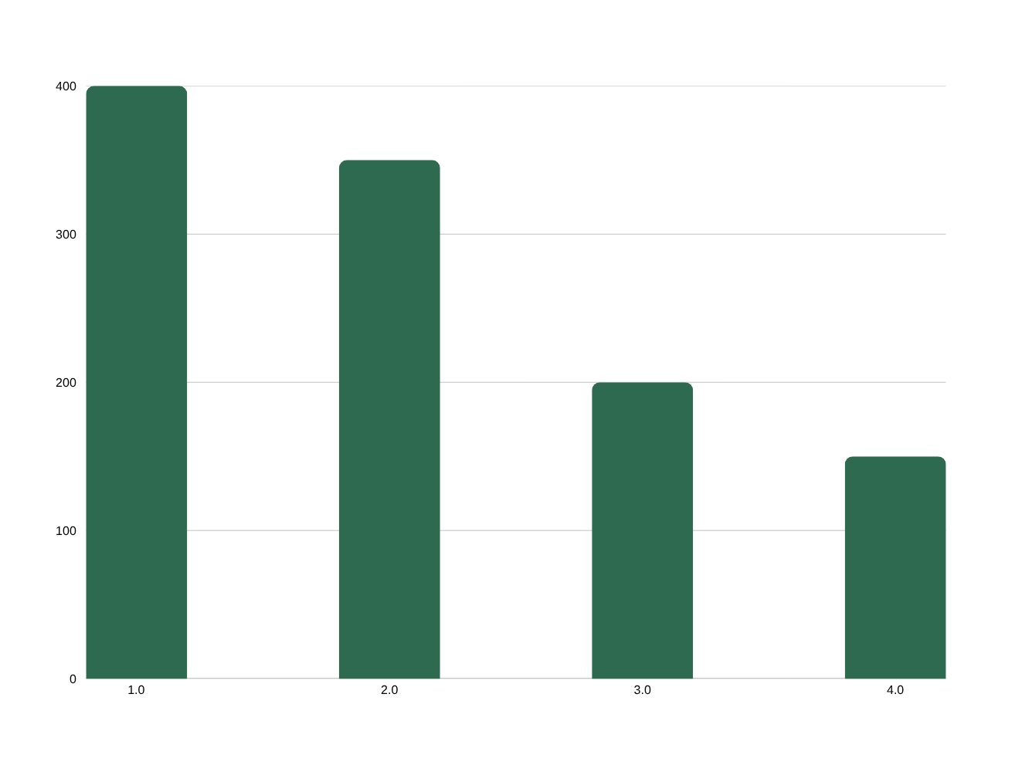
Dataset Overview
Custom Training Data for Silk Shield
Dataset Details
400 images
Healthy Silkworms
350 images
Infected (4 diseases)
200 images
High-Quality Cocoons
150 images
Low-Quality Cocoons
600 entries
Environmental Data Points
+ 600 environmental data entries for cocoon optimization models
Silkworm Disease Detection Using AI & ML | 16 April 2026
15
Notes:
15

Slide 16
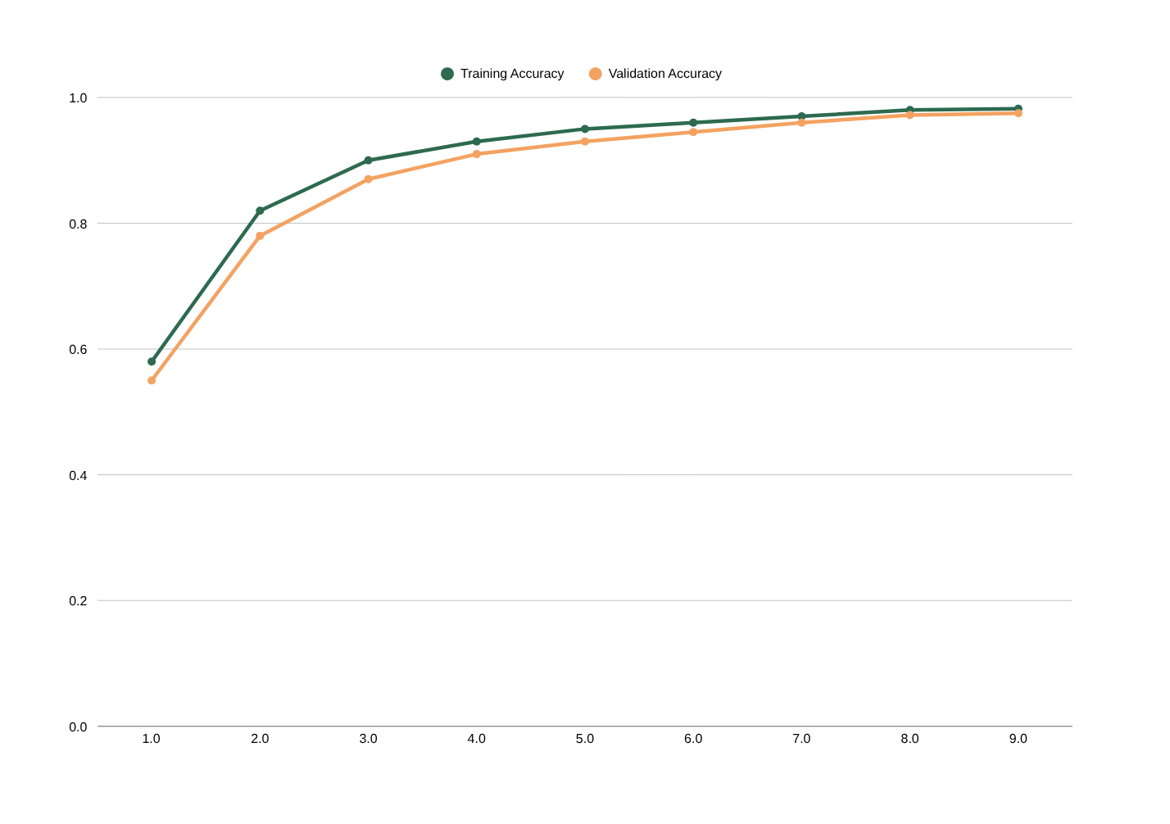
Model Accuracy Progression During Training
EfficientNet-B3 Training Results
Training Milestones
~58%
Initial Accuracy
(Epoch 0)
98.2%
Final Training
Accuracy
97.5%
Validation
Accuracy
~0.09
Final Validation
Loss
< 1 sec
Inference
Speed
Silkworm Disease Detection Using AI & ML | 16 April 2026
16
Notes:
16

Slide 17
Confusion Matrix – Model Evaluation
Near-Perfect Classification Results
True \ Pred | Healthy | Grasserie | Muscardine | Flacherie | Pebrine
Healthy | 120 | 0 | 0 | 0 | 0
Grasserie | 0 | 85 | 0 | 1 | 0
Muscardine | 0 | 0 | 95 | 0 | 0
Flacherie | 0 | 0 | 1 | 87 | 0
Pebrine | 0 | 0 | 0 | 0 | 80
Class-Wise Results
Class 0 – Healthy
120/120
100%
Class 1 – Grasserie
85/86
98.8%
Class 2 – Muscardine
95/95
100%
Class 3 – Flacherie
87/88
98.9%
Class 4 – Pebrine
80/81
98.8%
✅ Total Classification Error Rate: < 1% | Near-Perfect Multi-Class Disease Detection
Silkworm Disease Detection Using AI & ML | 16 April 2026
17
Notes:
17

Slide 18
Model Performance Metrics
Evaluation Summary – Silkworm Detection vs Cocoon Optimization
Metric | Silkworm Detection | Cocoon Optimization
Accuracy | 96% – 98% | 95% – 97%
Precision | 97.4% | 96.3%
Recall (Sensitivity) | 96.8% | 95.7%
F1-Score | 97.1% | 96.0%
Model Size | ~12 MB | ~13 MB
Inference Time | ~50 ms | ~60 ms
Validation Loss | ~0.09 | ~0.11
Device Compatibility | Raspberry Pi, Jetson Nano | Server/Cloud
98.2%
97.5%
Training Accuracy
Validation Accuracy
97.1%
<1 sec
F1-Score
Inference Speed
EfficientNet-B3 outperforms traditional CNNs (VGG16, ResNet50) while being significantly lighter and faster.
Silkworm Disease Detection Using AI & ML | 16 April 2026
18
Notes:
18

Slide 19
System Testing Strategy
Comprehensive Testing Framework
✔️
Unit Testing
🔗
Integration Testing
Image upload form, CNN prediction function, REST API endpoints, alert generation logic tested in isolation.
Frontend ↔ Backend API ↔ ML Model ↔ Database interactions verified end-to-end.
🖥️
System Testing
⚡
Performance Testing
Complete workflow: Upload image → Disease classified → Alert/recommendation displayed.
Image prediction time < 1 second. Inference 1.6-1.7 sec on slow networks. Server response under load.
👤
User Testing
🔒
Security Testing
Field tests with small/large-scale farmers & extension officers. Multilingual UI verified in Kannada, Tamil.
Secure image upload validated. Malicious file types (.pdf, .txt) blocked. Authentication & data protection.
Silkworm Disease Detection Using AI & ML | 16 April 2026
19
Notes:
19

Slide 20
Unit Test Cases – Key Results
All Test Cases Passed ✅
Test ID | Module | Description | Input | Result
IU01 | Image Upload | Upload valid JPG image | silkworm.jpg | ✅ Pass
IU02 | Image Upload | Upload unsupported file type | silkworm.pdf | ✅ Pass
DD01 | Disease CNN | Predict disease for infected image | Flacherie worm | ✅ Pass
DD02 | Disease CNN | Predict disease for healthy image | Healthy silkworm | ✅ Pass
DD05 | Disease CNN | Model inference timing | Image input | ✅ 1.6 sec
AR01 | Alert Module | Display treatment for Grasserie | Grasserie prediction | ✅ Pass
UI04 | UI Module | Language switch to Hindi | Select Hindi | ✅ Pass
SYS01 | System | Full workflow with Grasserie image | Valid infected image | ✅ Pass
SYS05 | System | Prediction latency check | Valid image | ✅ 1.7 sec
UTS03 | User Testing | Usability for limited digital literacy | Simple UI | ✅ Pass
Silkworm Disease Detection Using AI & ML | 16 April 2026
20
Notes:
20

Slide 21
Feasibility & Risk Analysis
Technical, Economic & Operational Evaluation
📉 Data Availability Risk
Medium
🔮 Model Generalization Risk
Medium
⚠️ Risk: Limited publicly available labeled datasets specific to silkworm diseases.
⚠️ Risk: Model may underperform on real-world noisy or blurry images from field conditions.
✅ Mitigation: Custom dataset collection from field + data augmentation (rotation, flip, brightness)
✅ Mitigation: Extensive augmentation + image quality checks with user feedback loop
👨‍🌾 User Adoption Risk
Low
📡 Connectivity Risk
Low
⚠️ Risk: Resistance from farmers unfamiliar with smartphones or technology.
⚠️ Risk: Poor internet in rural areas may disrupt cloud-based inference.
✅ Mitigation: Intuitive UI, regional language support, NGO-organized training sessions
✅ Mitigation: Edge computing via TensorFlow Lite for offline detection on mobile devices
Silkworm Disease Detection Using AI & ML | 16 April 2026
21
Notes:
21

Slide 22
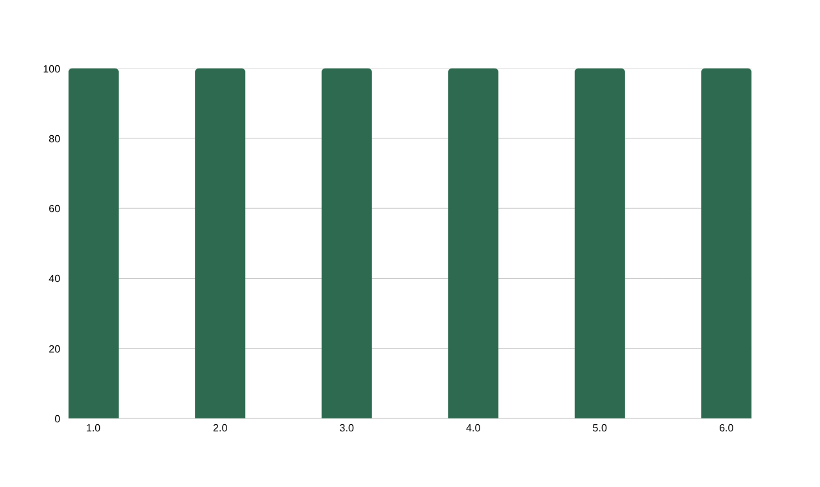
User Testing – Acceptance Results
Real-World Validation with Farmers & Field Officers
User Acceptance Testing Objectives
User Feedback Highlights
• Validate ease of use & understanding | Ensure accurate disease detection
✅
Image upload intuitive for non-tech-savvy farmers
• Evaluate alert helpfulness | Identify usability issues & feature gaps
✅
Disease results shown clearly with actionable advice
✅
Kannada/Tamil UI switch works flawlessly
✅
Step-by-step guidance reduces confusion
✅
Prediction in < 2 seconds even on slow internet
✅
Offline mode via edge model works in rural areas
Silkworm Disease Detection Using AI & ML | 16 April 2026
22
Notes:
22

Slide 23
Climate-Based Cocoon Optimization
Maximizing Silk Yield Through Environmental Intelligence
How It Works
Cocoon Optimization Results
🌡️
Temperature Monitoring – Sensors track real-time temperature. Optimal range: 23–28°C for peak cocoon quality.
95%–97%
96.3%
💧
Humidity Analysis – Humidity levels maintained at 70–85%. RNN model predicts optimal conditions from historical data.
Accuracy
Precision
95.7%
96.0%
🌬️
Air Quality Tracking – CO₂ and air quality indices monitored. Poor air quality triggers preventive alerts.
Recall
F1-Score
📊
Predictive ML Model – RNN-based model analyzes environmental trends to recommend optimal rearing adjustments.
~13 MB
~60 ms
🏆
Cocoon Grading – Predicts cocoon quality grade (A/B/C) based on environmental + genetic factors.
Model Size
Inference Time
Silkworm Disease Detection Using AI & ML | 16 April 2026
23
Notes:
23

Slide 24
Conclusion
Silk Shield – Bridging AI and Agriculture
🎯
Successfully demonstrated CNN-based (EfficientNet-B3) silkworm disease detection with 96–98% accuracy
⚡
Real-time detection enables timely preventive and curative action, reducing disease outbreak risk
📱
User-friendly mobile/web interface with multilingual support reaches rural farmers effectively
🌡️
Climate-based cocoon optimization improves silk yield and quality by adapting to environmental factors
💰
Low-cost, open-source implementation (TensorFlow, Flask, Python) makes it viable for small-scale farmers
🌱
Contributes to sustainable silk production, increased profitability, and smart agriculture adoption
Silkworm Disease Detection Using AI & ML | 16 April 2026
24
Notes:
24

Slide 25
Future Scope
Enhancing Silk Shield for Tomorrow
📡 Edge Computing for Offline Use
🧬 Broader Disease Coverage
🌦️ Real-Time Weather Integration
Deploy TF Lite models on mobile devices for offline detection in areas with poor internet connectivity.
Train on broader datasets covering more silkworm breeds and rare diseases for comprehensive protection.
Incorporate live weather API data for predictive outbreak alerts based on climate patterns.
🔌 IoT Integration
🏛️ Government Portal Integration
📲 SMS Alert Systems
Connect with IoT-based silkworm rearing environments for automated environmental monitoring.
Link with national agri-portals and agricultural departments for policy-level disease tracking.
Implement SMS-based alerts in local languages for farmers without smartphones in remote areas.
Silkworm Disease Detection Using AI & ML | 16 April 2026
25
Notes:
25

Slide 26
References
Key Research & Technical Resources
[1] Binson V.A., Manju G. – 'Automated Disease Detection in Silkworms Using ML' – ResearchGate, Oct. 2024
[2] Md. Manowarul Islam et al. – 'Deep Learning for Cotton Disease Prediction Using Fine-Tuning' – IEEE, 2024
[3] Gul Munir et al. – 'Deep Learning-Based Multi-Crop Disease Detection System' – IEEE, 2024
[4] W.Q. Li et al. – 'Enhanced Pest & Disease Detection in Agriculture Using Deep Learning-Enabled Drones' – 2024
[5] J.K. Patel, M.S. Reddy, L.K. Sharma – 'Deep Learning-Based Pest Recognition System for Sericulture' – 2024
[6] S.L. Nguyen, T.H. Tran, Q.V. Pham – 'Climate-Aware Cocoon Quality Optimization Using Deep Learning' – 2024
[7] H. He et al. – 'Integrated Analysis of ML and DL in Silkworm Pupae Species & Sex Identification' – Animals, 2023
[8] H. He et al. – 'Development of Deep & ML Convolutional Networks for Disease Detection in Agriculture' – 2025
[9] H. He et al. – 'Explainable Deep Learning Model for Mulberry Leaf Disease Identification' – Frontiers, 2023
[10] H. He et al. – 'IoT, ML and AI for Disease Forecasting Amidst Climate Change' – Precision Agriculture, 2024
Silkworm Disease Detection Using AI & ML | 16 April 2026
26
Notes:
26

Slide 27
THANK YOU!
Silkworm Disease Detection Using AI & Machine Learning
DIKSHA [AMB2065] l MANASA M [AMB2130| MAHESH PATIL [AMB2124]
IV Year B.Sc (Hons.) Agriculture | COA, UAS, GKVK, Bengaluru-65
Guided by: Dr. D R Kumar Raja | Academic Year: 2025–2026
"The silkworm spins out his life, and, wrapping himself in his labor, dies."
Silkworm Disease Detection Using AI & ML | 16 April 2026
27
Notes:
27

